Slide 2
Practical Steps - Snapchat
Snaps automatically disappear after they're sent but they can still be screenshotted so it's important to be careful.
To change your privacy settings on Snapchat, go to your profile and tap the gear icon. Scroll down to
"Who can...":
Contact me: select friends only
View my story: select friends only
See my location: choose ghost mode
Show me in quick: add Turn this off.
It can also help to remember:
To block people you don't know who add you, including friends of friends
If you're in a group chat, anyone in the group can talk to you and see your messages.

Slide 3
Practical Steps - Snapchat
To make a report:
In the app, go to the person’s Snapchat account
Press the 3 dots or the cog wheel
Press ‘Report’
To report a Snapchat or Snapchat Live Story that contains nudity or bullying content:
Press and hold the snap or story
Press the flag in the bottom left hand corner
Select the reason you're making a report
If you're reporting bullying you might be asked to give more information, it's important to explain as much as possible
After you've made the report you'll be asked whether you would like to block the person, doing this can help to stop them upsetting you.

Slide 4
Practical Steps - Instagram
Report something you find threatening
In the app:
Press the 3 dots in the top right hand corner above the picture or video
Select Report
Select the reasons you want to report the image.
If someone is bullying, threatening or sending photos to you via direct message, you can also report that.
In the app:
Open the direct message from the person you want to report
Press the i in the top right hand corner
Select Report and enter the reasons you want to report them
You can also block the person by pressing Block User.

Slide 5
Practical Steps – WhatsApp.
If someone is bullying or harassing you, or sending inappropriate photos of you then you can report and block them. This won’t delete any photos they’ve saved but can get them banned from using the app.
To block or report someone:
Go to the chat with the person you want to report
Tap on the group or person’s name to open their profile
Scroll down and press Report
You can also block the person on this page.
Blocking someone on messenger apps means they won’t be able to send you nasty messages.
Usually the other person won’t know that you’ve blocked them. You'll just appear offline when they look at their contacts.

Slide 6
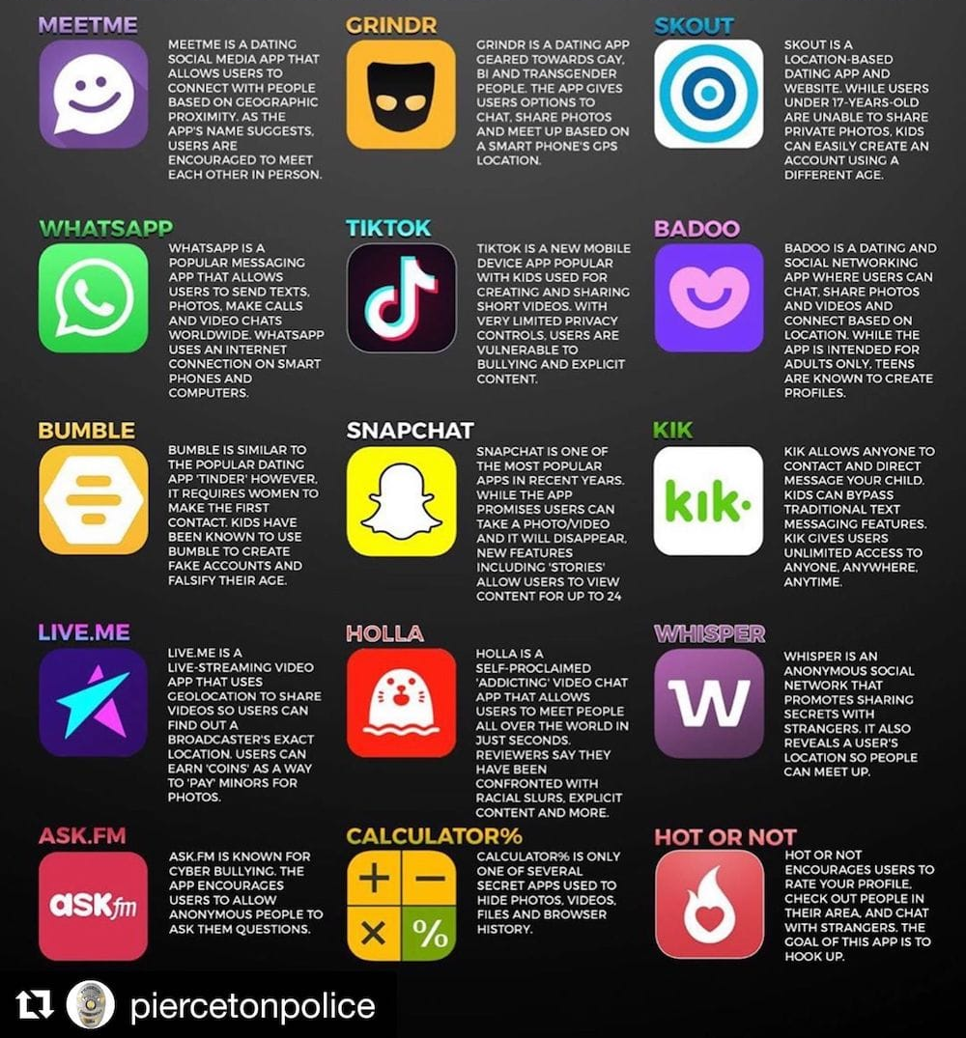
15 apps parents should know about

